Slide 1


Analyzing Paid Search Campaign Data
for Mall Business
Business Analytics - Sekolah Data Pacmann
pacmann.io
© 2022 – Pacmann AI

Slide 2
Outline
Introduction
Explain the Topics, Datasets, and Tool #Stage 1
Define Problem Statements, Goals, Metrics, and Scenario #Stage 2
Create Dashboard User Flow #Stage 3
Data Cleaning #Stage 4
Build Dashboard and Gain Business Insights #Stage 5
Conclusion
References

Slide 3
Introduction
Notes:
Transisi antar outline

Slide 4
Introduction
This is final project Business Analytics in Pacmann course. As a data analyst, being able to explore data, find solutions to problems, and produce actionable insights is a crucial skill that must be possessed. Therefore, in this project, I aim to put these skills into practice and demonstrate my proficiency in leveraging data for meaningful decision-making. We know that marketing analytics is one of the main branches of business analytics. In this analysis, a company's advertising campaign is analyzed.

Slide 5
Topic, Dataset, and Tool
Notes:
Transisi antar outline

Slide 6
Topics
"Analyzing Paid Search Campaign Data for Mall Businesses" discusses how paid advertising campaign data is utilized to analyze the performance of mall businesses and optimize their marketing strategies. Additionally, it delves into the use of data and data analysis methods to provide better insights to mall business owners.

Slide 7
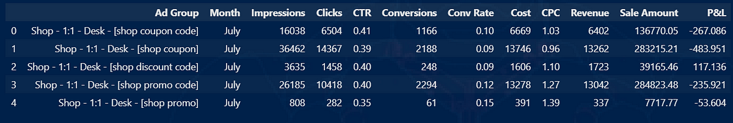
Dataset
In this project, there is a real dataset from Kaggle it containing data of a 2021, 5 months paid search campaign of a Us shopping mall (that for privacy reasons for this project the name has been anonymized) promoting through paid search coupons and promo codes. The dataset contains information about the ad group advertising, clicks, conversions, impressions, revenues and costs(see below the dataset dictionary).

Slide 8


Tool
The tools used in this project are Visual Studio Code (.ipynb) for data preprocessing and Tableau for dashboard visualization.

Slide 9
Problem Statements, Goals,
Metrics, and Scenario
Notes:
Transisi antar outline

Slide 10
Problem Statements, Goals,
Metrics, and Scenario
A Shopping Mall company ran several kinds of advertisements in July-November 2021. Companies want to save marketing budgets without reducing ad performance, so companies must be wiser in advertising.
Companies want to know whether the campaign so far is profitable and which types of ads have the best performance. So that will be objective and by result of that objective, companies can use their marketing budget more effectively.
The metrics used are in accordance with those listed in the dataset, namely impression, clicks, conversion, CTR, conversion rate, CPC, revenue, sale amount, profit & loss. Also added is the CPM (Cost per Mille) metric, which is the cost incurred for 1000x ad views.
Marketing Manager wants to increase the effectiveness of advertising in generating profits. Marketing Manager needs a dashboard to see the performance of ads that have been run and focus ad serving on the type of ad that brings the best profit but does not reduce its performance in the field of Brand Awareness and Traffics Generated.

Slide 11
Dashboard Userflow
Notes:
Transisi antar outline

Slide 12
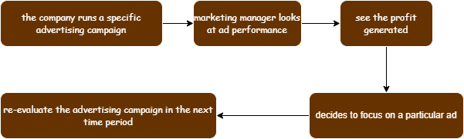
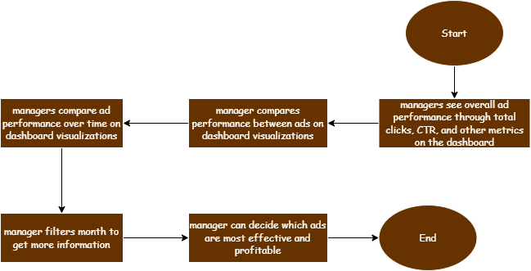
Storyline and Userflow

Slide 13
Data Cleaning
Notes:
Transisi antar outline

Slide 14
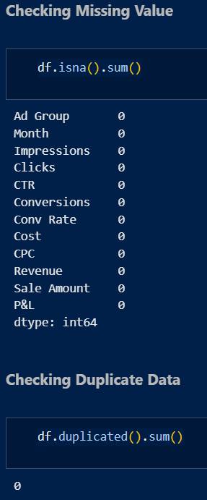
Data Cleaning
There isn’t missing value and duplicated data

Slide 15
Dashboard Visualization
Notes:
Transisi antar outline

Slide 16
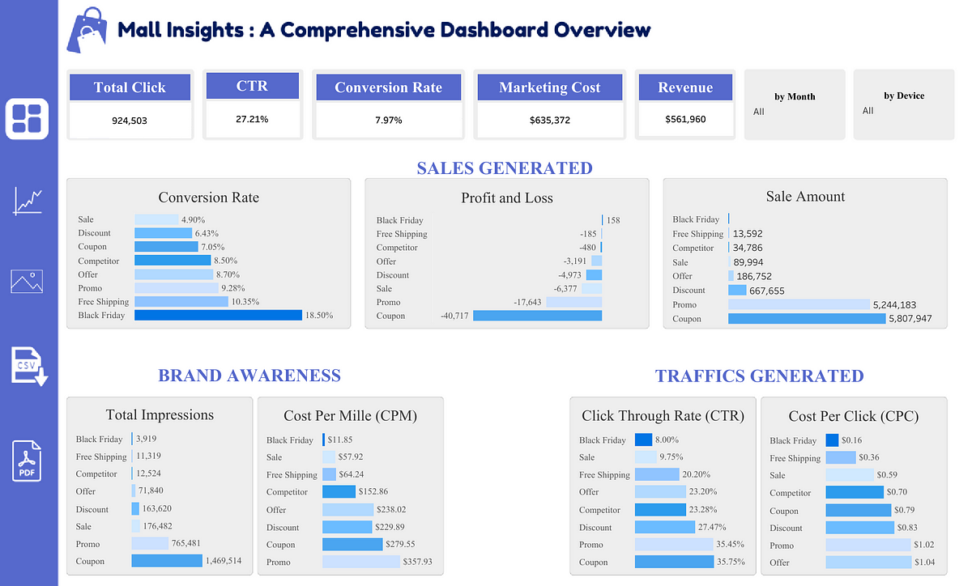
Dashboard Overview
View dashboard

Slide 17
Insights
Notes:
Transisi antar outline

Slide 18
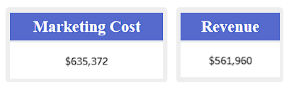
1. In the overall campaign profitable?
Overall, the advertising campaign that is run is still less profitable because the revenue generated is smaller than the marketing cost. Therefore, the analysis will be focused on the month when the company made a profit.

Slide 19
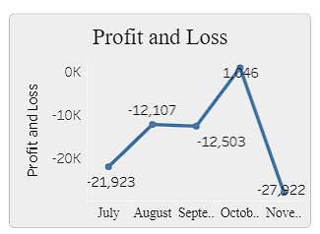
2. In what month does the company make a profit?
We can see in October the company made a profit. Therefore, it will be analyzed which ads have performed well in that month.

Slide 20

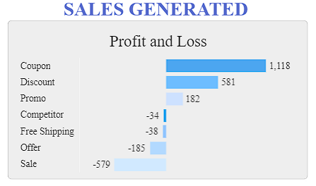
3. Which ads contributed the most profit that month?
We can see the ads that give the most profit in October are Coupon, Discount, and Promo. Therefore, it will be analyzed whether Coupon, Discount, and Promo ads have a significant impact on brand awareness and traffic.

Slide 21
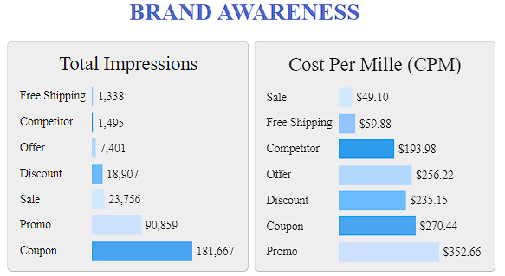
4. How are these ads performing in terms of Brand Awareness?
See that Coupon ads provide the highest impressions and are much more significant than Discounts and Promo. However, if you look at the cost per mille, Discount ads are more effective than Coupon and Promo ads even though the difference is not too significant.

Slide 22
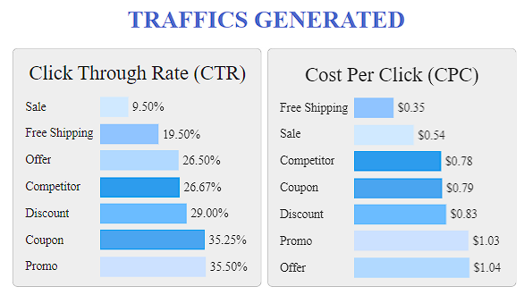
5. How are these ads performing in terms of Traffics Generated?
Promo, Coupon, and Discount ads include the 3 ad types with the highest CTR. Promo ads at 2nd place with the highest CPC, Coupon and Discount ads have costs that are not too high and not too low. Therefore, it can be concluded that the performance of the three ads in the aspect of traffics generated is quite good. In the future, further analysis can be done for the months when the company suffered losses to find out the cause of the loss, what ads were run, and their performance.

Slide 23
Conclusion
Notes:
Transisi antar outline

Slide 24
Conclusion
Overall, the advertising campaigns run by the company have not been profitable and have always lost money in every month except in October. In October, the three ad types that have the best performance in terms of brand awareness, traffics generated, and sales generated are Coupon, Discount, and Promo ad types.
Therefore, with the current analysis, it can be concluded that the company can consider focusing more on these three types of ads to answer the Marketing Manager's need to save marketing budget without reducing ad performance.
Of course, further deeper analysis can be done first, especially for analysis in months that experience losses.

Slide 25
Reference
[1] https://siswa.pacmann.ai
[2] Regression and Other Stories. — Andrew Gelman, Jennifer Hill, and Aki Vehtari
[3] Carlos Silva. (2022 December 15). 12 SEO Techniques to Boost Organic Traffic + Rankings. Retrieved January 29, 2023, from https://www.semrush.com/blog/seo-techniques/
[4] Vallaeys, F. (2021, June 23). Google phrase match: Everything you need to know. Search Engine Journal. Retrieved January 18, 2023, from https://www.searchenginejournal.com/google-phrase-match-guide/410514/

Slide 26
Thank You
Notes:
Transisi antar outline

